Slide 1


Regression analysis for house sales in King County
By –
Ashwinkumar Bhagwat
Ankit Vishwakarma
Praveen Sharma
Sumit Roy

Slide 2
OVERVIEW
Problem Statement:
Develop a model to predict house sale prices in King County. Compare various machine learning models to determine the most accurate model for informed decision-making by real estate agents, homeowners, and buyers.
About Dataset:
This dataset contains house sale prices for King County, which includes Seattle. It includes homes sold between May 2014 and May 2015.
Machine Learning models used for predict sales price:
Multiple Linear Regression
Polynomial Regression

Slide 3
Our Approach
Data Cleaning
Model fitting
Predicting values and determining the optimal model.
(Pandas, sk-learn)​
(PYTHON(sk-learn)
(python)
Removing outliers and eliminating redundant columns.
Python used to train and fit machine learning models.

Slide 4
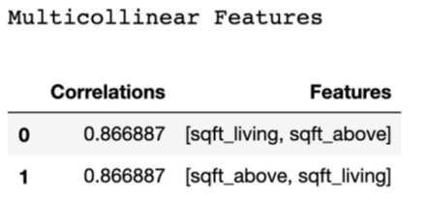
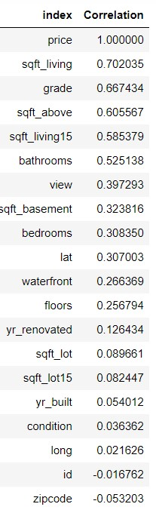
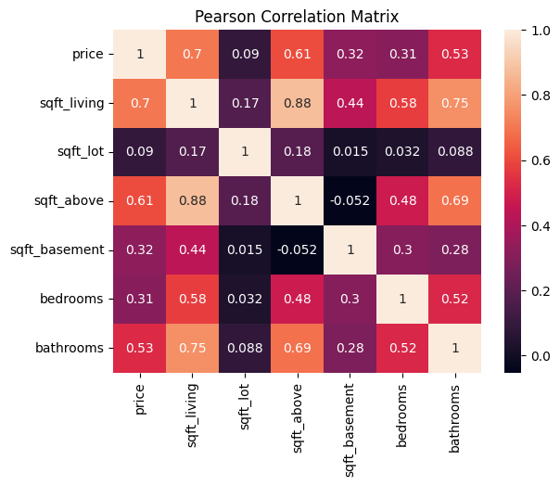
Correlation and multicollinearity
Correlation with variables.

Slide 5
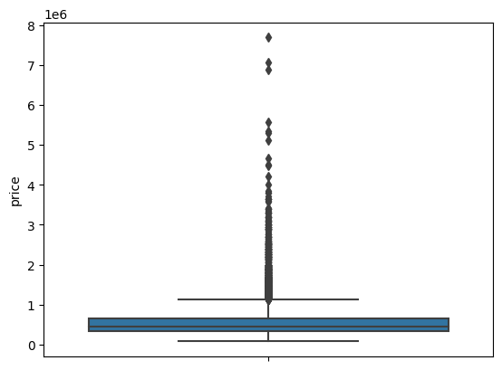
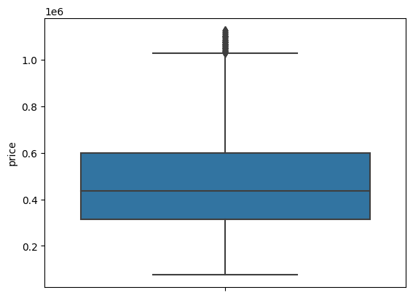
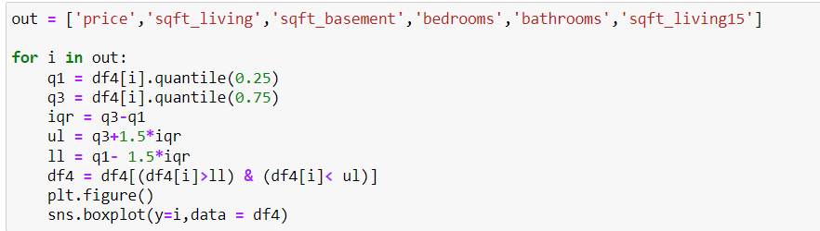
Pre-processing and removing outliers.
Outliers
Before
After

Slide 6
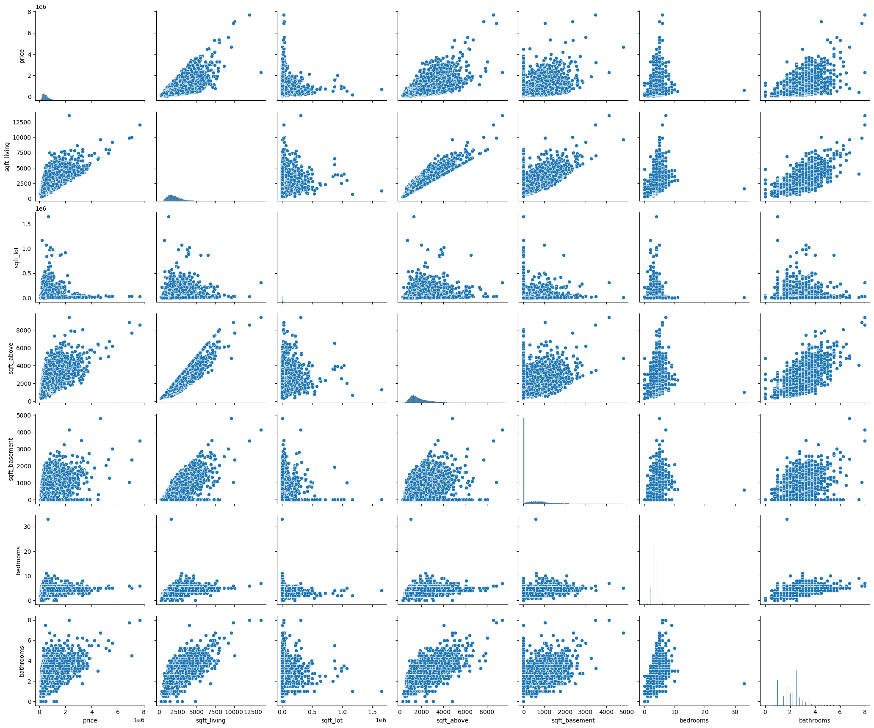
Pair-Plot.

Slide 7
Regression Models

Slide 8
Linear model - A
Considered columns for these model.
price
bedrooms
bathrooms
sqft_living
sqft_lot
floors
waterfront
view
condition
grade
sqft_above
sqft_basement
yr_built
yr_renovated
zipcode
lat
long
sqft_living15
sqft_lot15
 | LINEAR MODEL-A
R2 SCORE | 0.6708
mean_absolute_error | 91383.4795
mean_squared_error | 12201792003.4977
Accuracy of a model is 0.67

Slide 9
Linear model - B
The model only includes features with a correlation coefficient greater than 0.30 and multicollinearity has been addressed by their removal.
Considered columns for these model.
price
bedrooms
bathrooms
sqft_living
view
grade sqft_basement
lat
sqft_living15
 | LINEAR MODEL-A
R2 SCORE | 0.6082
mean_absolute_error | 91383.4795
mean_squared_error | 15097114199.3483
Accuracy of a model is 0.60.

Slide 10
Polynomial regression
The model only includes features with a correlation coefficient greater than 0.25.
Considered columns for these model.
bedrooms
bathrooms
sqft_living
floors
waterfront
view
grade
sqft_above
sqft_basement
lat
sqft_living15
 | P. REGRESSION
R2 SCORE | 0.75736
mean_absolute_error | 113298.0833
mean_squared_error | 31144158601.436
Accuracy of a model is 0.75

Slide 11
Conclusion
MODELS | R2_score
LINEAR - A | 0.6708
LINEAR - B | 0.6082
POLYNOMIAL MODEL | 0.75736
Based on the R2 scores of the different models, the polynomial regression model performed the best with an R2 score of 0.75, indicating that it was able to explain 75% of the variance in the dependent variable.

